Slide 1

8th & Gale Market Place
2645 8th Avenue South, Nashville, TN
Dynamic 8th Avenue South Corridor
1,380 – 4,925 SF Available Fall 2019
Retail For Lease

Slide 2
8th Avenue Elevation

Slide 3
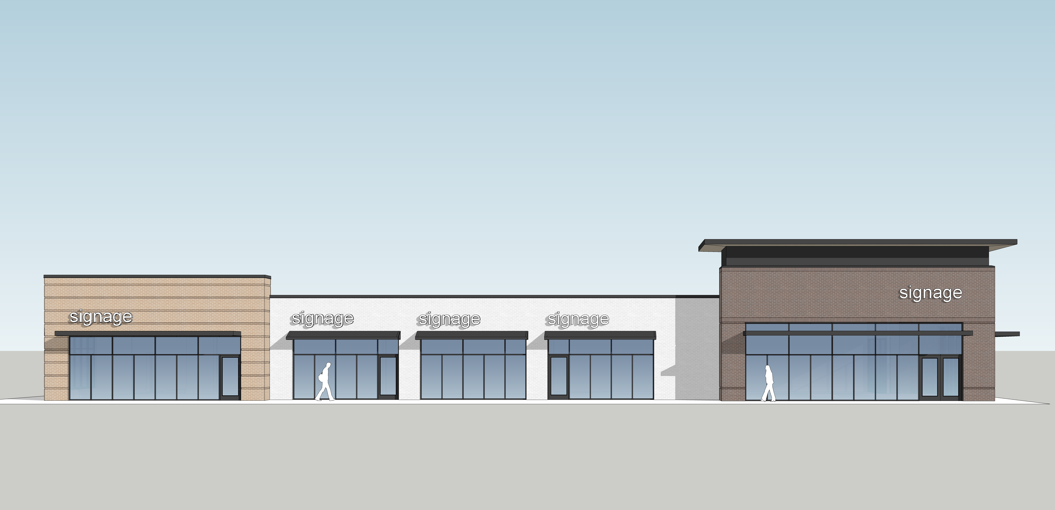
Parking Lot Elevation

Slide 4
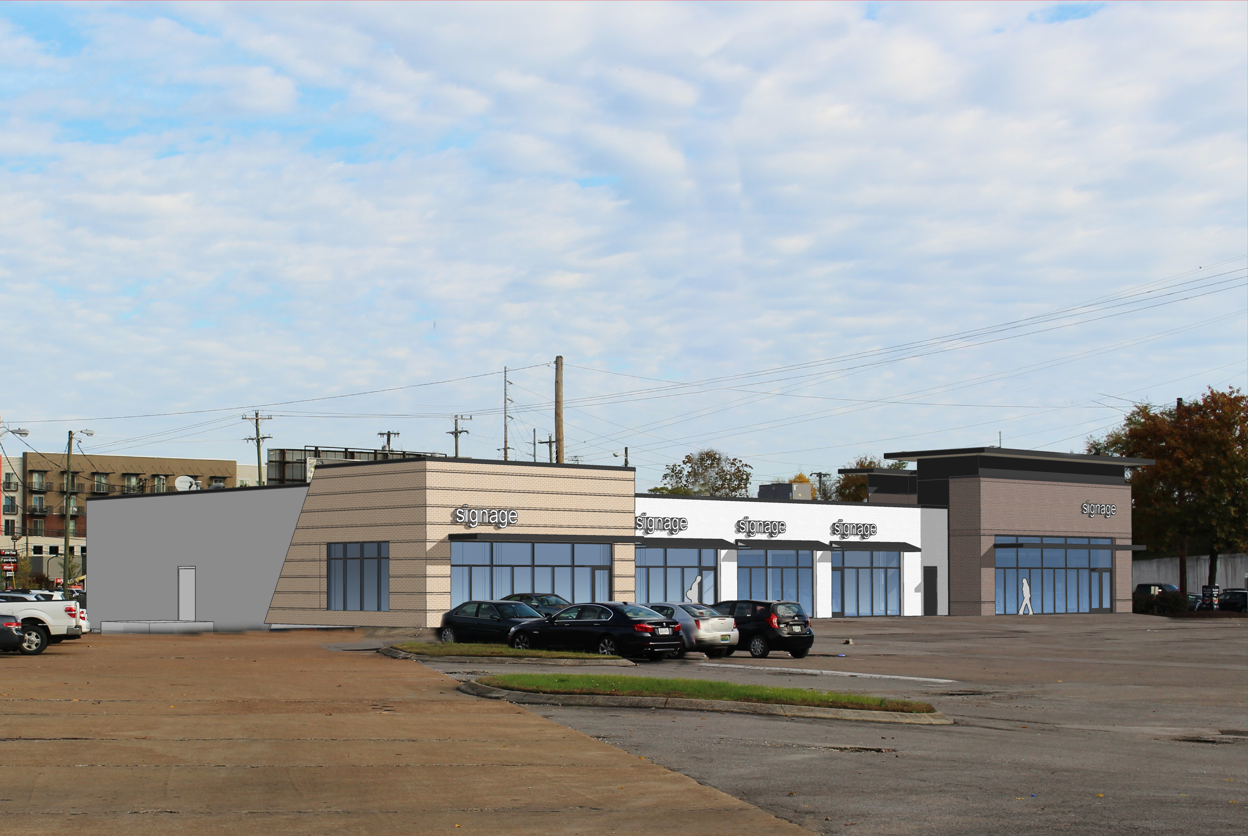
View from Gale Lane

Slide 5
View from 8th Avenue

Slide 6
View from Main Entrance

Slide 7
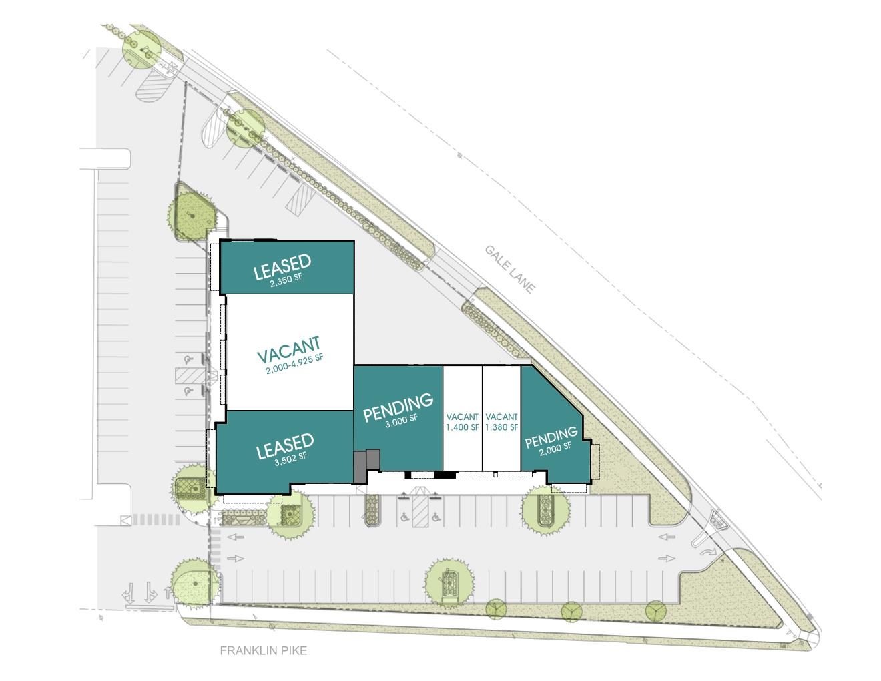
Located at the corner of Gale Lane & 8th Avenue South at I-440
18,442 square foot shopping center
1,380- 4,925 SF available
23,055 AADT on 8th Avenue South
Exceptional visibility
Multiple access points
Signalized intersection
Abundant parking
8TH AVENUE SOUTH
Overview

Slide 8
ADDRESS:
TOTAL SF:
AVAILABLE SF:
YEAR BUILT:
TRAFFIC COUNTS:
ACCESS TO CENTER:
2645 8th Avenue South
Nashville, TN
18,442 SF
1,380 SF –4,925 SF
1988 / 2019 Renovated
23,055 AADT along 8th
Avenue South
Two access points off 8th Avenue South; additional access via Gale Lane and
Berry Road
The Property
Shopping Center Details

Slide 9
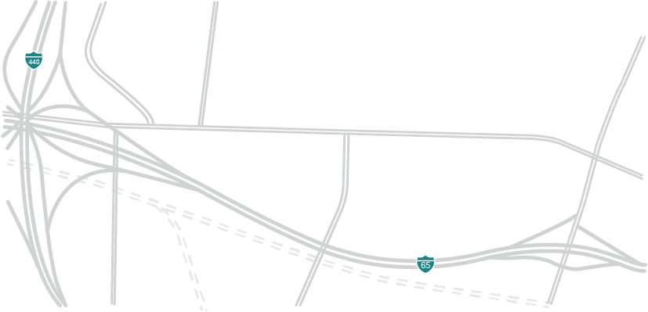























The Property
Eighth South
52 Units
IMT 8 South
330 Units
The Smiling Elephant
8th Ave. South
Gale Lofts
95 Units
Wedgewood Ave.
23Hundred @ Berry Hill
266 Units
The Melrose Phase II
138 Units
The Melrose Phase I
220 Units
Octave
321 Units
Location

Slide 10
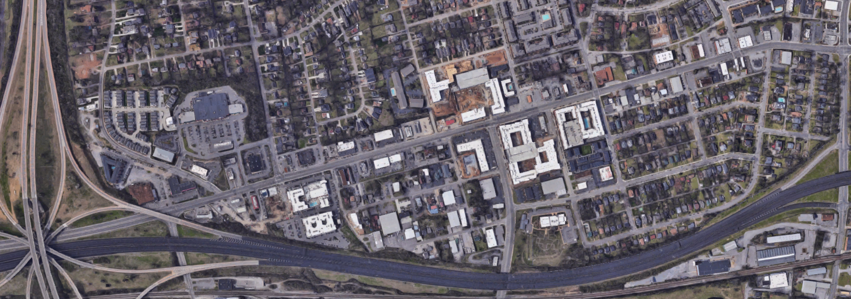



24
25
28
23,055 AADT
21
26
27
5
23
1
2
4
22
The Property
18
19
20
7
Wedgewood Ave
10
17
15
16
6
1
3
4
5
9
1
12
13
14
8
11
Franklin Pike/8th Ave S
6
7
2
3
 | Retailers
1 | 8th & Gale Market Place
2 | Kroger
3 | Jimmy Johns
4 | Chick-fil-a
5 | Walgreens
6 | Mapco
7 | McDonalds
8 | Regions
9 | Dollar Tree
10 | M.L. Rose
11 | Sutler
12 | Fenwick’s
13 | Sinema
14 | NTB
15 | Sherwin Williams
16 | Xfinity
17 | SunTrust
18 | Sonic
19 | Holler & Dash
20 | Cilantro
21 | Smiling Elephant
22 | Hattie B’s
23 | Urban Juicer
24 | Shell
25 | Burger King
26 | 8th & Roast
27 | Subway
28 | Exxon
 | Multifamily
1 | Gale Lofts – 95 Units
2 | The Melrose II – 138 Units
3 | The Melrose I – 220 Units
4 | Eighth South – 52 Units
5 | IMT 8 South – 330 Units
6 | Octave – 321 Units
7 | 23Hundred at Berry Hill – 266 Units
Aerial

Slide 11
Demographics

Slide 12
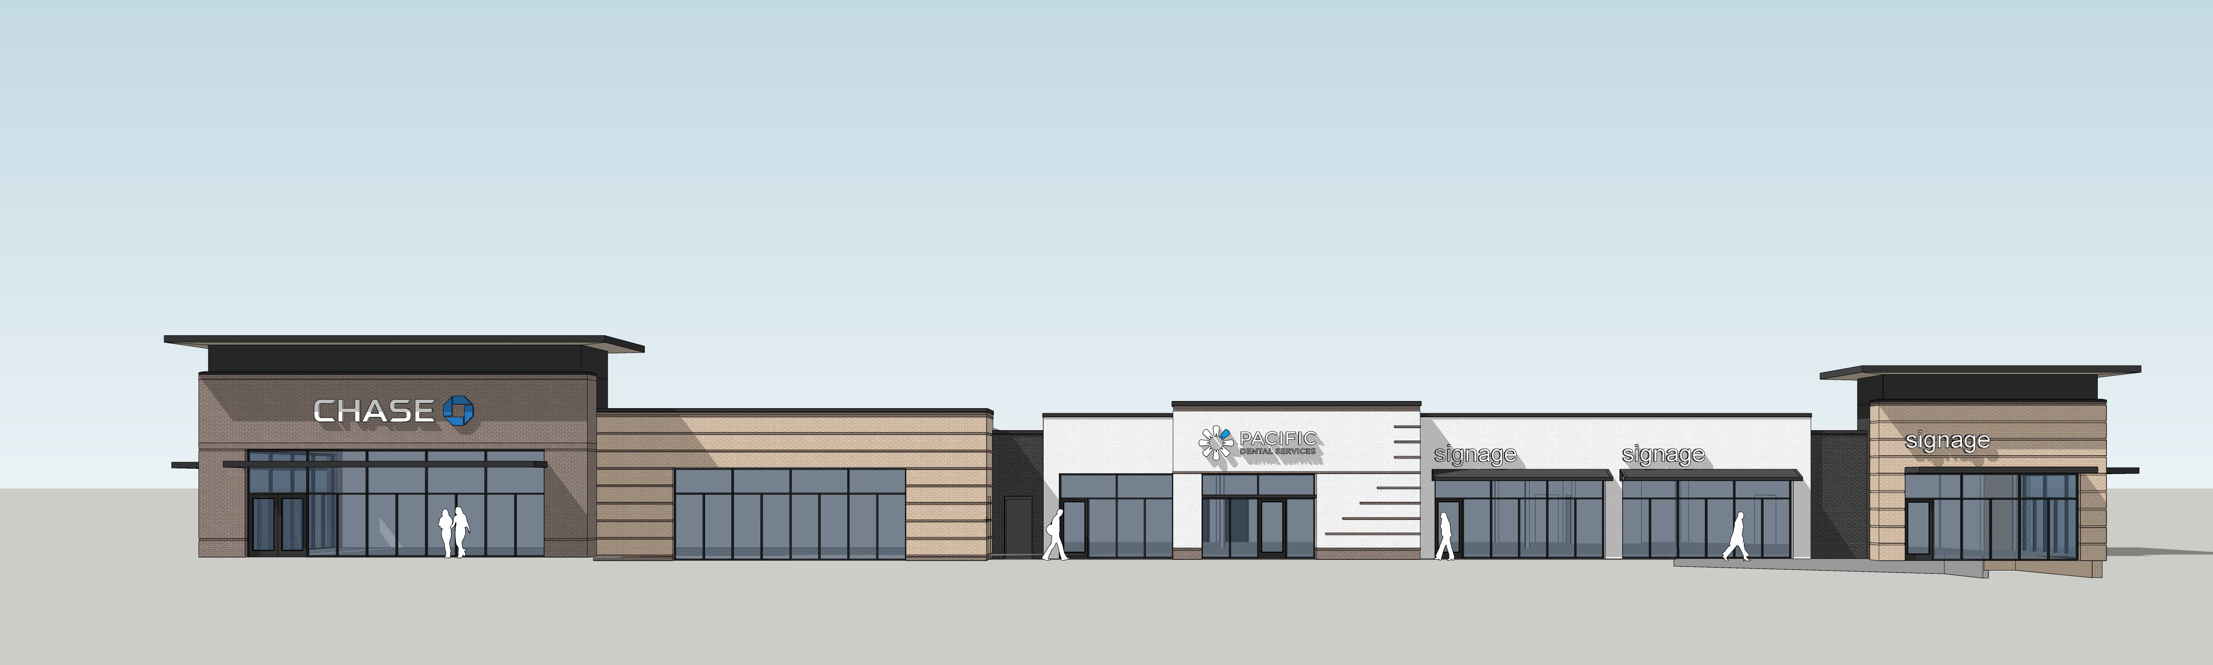
FOR MORE INFORMATION CONTACT:
CHRIS SMITH
csmith@fidelityreg.com
Fidelity Real Estate Group, Inc.
102 Woodmont Blvd, Suite LL-110
Nashville, TN 37205
P. 615.297.7400

