Slide 1
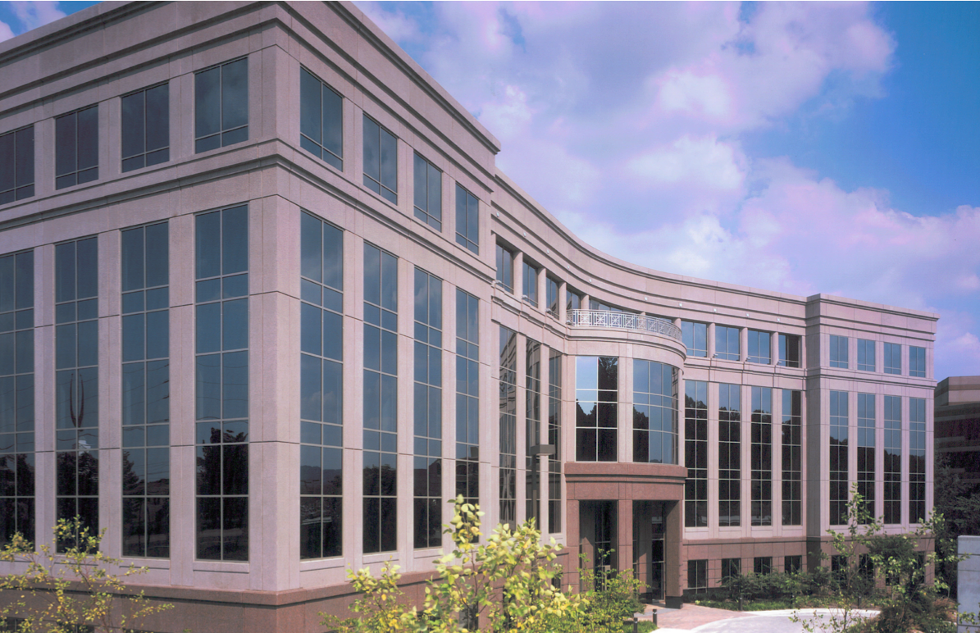
For Lease
Burton Hills IV
40 Burton Hills Blvd
Class A Office Space
Professional office park setting
Card Key Access
Convenient to many restaurant and retail amenities
Ample parking
Located off Hillsboro Road in the heart of Green Hills
Suite 400: 10,305 sf available
For More Information Contact:
Chris G. Smith
Fidelity Real Estate Group, Inc.
615.727.0114
csmith@fidelityreg.com
102 Woodmont Blvd, - Suite LL-110 - Nashville, TN – 37205 - P. 615.297.7400 - F. 615.297.7427

Slide 2
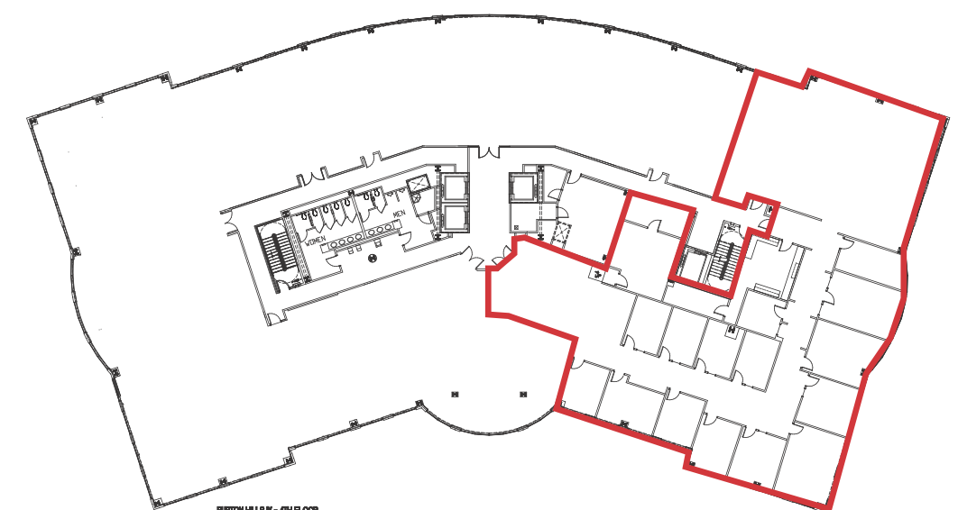
Floorplan & Amenities
Suite 400: 10,305 SF
Amenity Map
Hillsboro Road
Burton Hills IV
102 Woodmont Blvd, - Suite LL-110 - Nashville, TN – 37205 - P. 615.297.7400 - F. 615.297.7427

