Slide 1

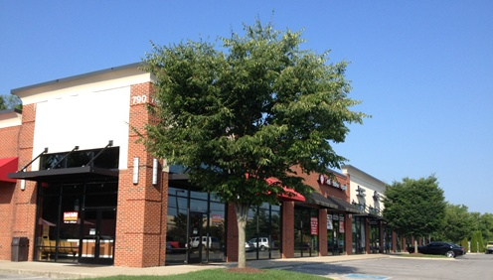
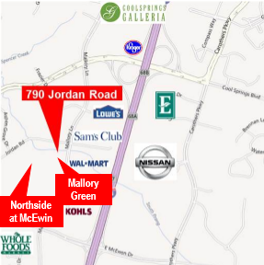
For Lease
Cool Springs Collection
790 Jordan Road
Franklin, TN
15,000 square feet of retail space in the heart of Cool Springs
Connected to 500,000 square foot
Mallory Green Mixed Use Development
Adjacent to $270 Million Mixed Use Northside at McEwen Development
Traffic counts: 33,111 cars per day
Williamson County is number one in per capita income in the State of TN
Fidelity Real Estate Group, Inc.
102 Woodmont Blvd, Suite LL-110
Nashville, TN 37205
P. 615.297.7400 F. 615.297.7427
For More Information Contact:
Allison A. Powers, CPM
615.727.0116
apowers@fidelityreg.com

Slide 2
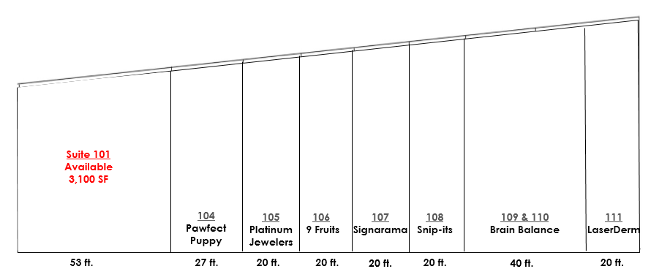
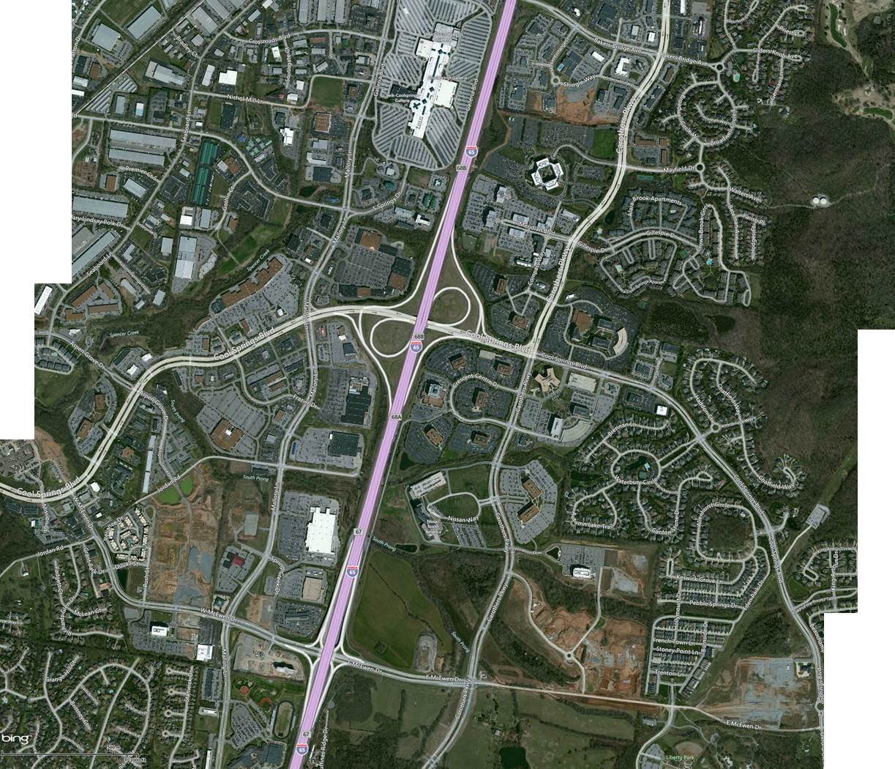





For Lease
Cool Springs Collection
CHS
HQ
Healthways
HQ
Nissan
HQ
Site
Fidelity Real Estate Group, Inc.
102 Woodmont Blvd, Suite LL-110
Nashville, TN 37205
P. 615.297.7400 F. 615.297.7427
For More Information Contact:
Allison A. Powers, CPM
615.727.0116
apowers@fidelityreg.com

Slide 3
