Slide 1
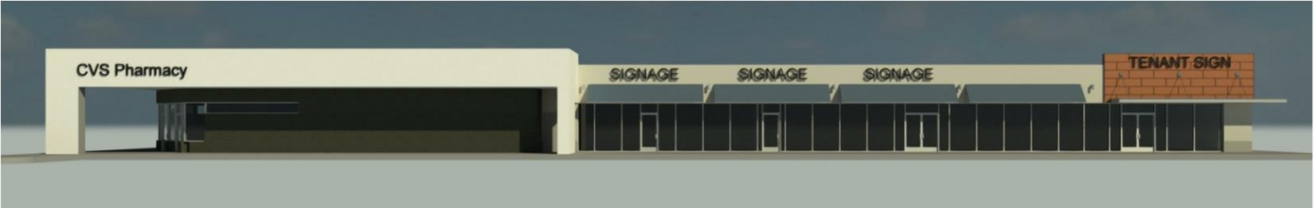

Retail For Lease
CVS Anchored Shopping Center
2645 Franklin Pike, Nashville, TN
Soon to be Under Renovation
Dynamic Franklin Pike Corridor
1,700 – 7,350 SF Available January 2019

Slide 2
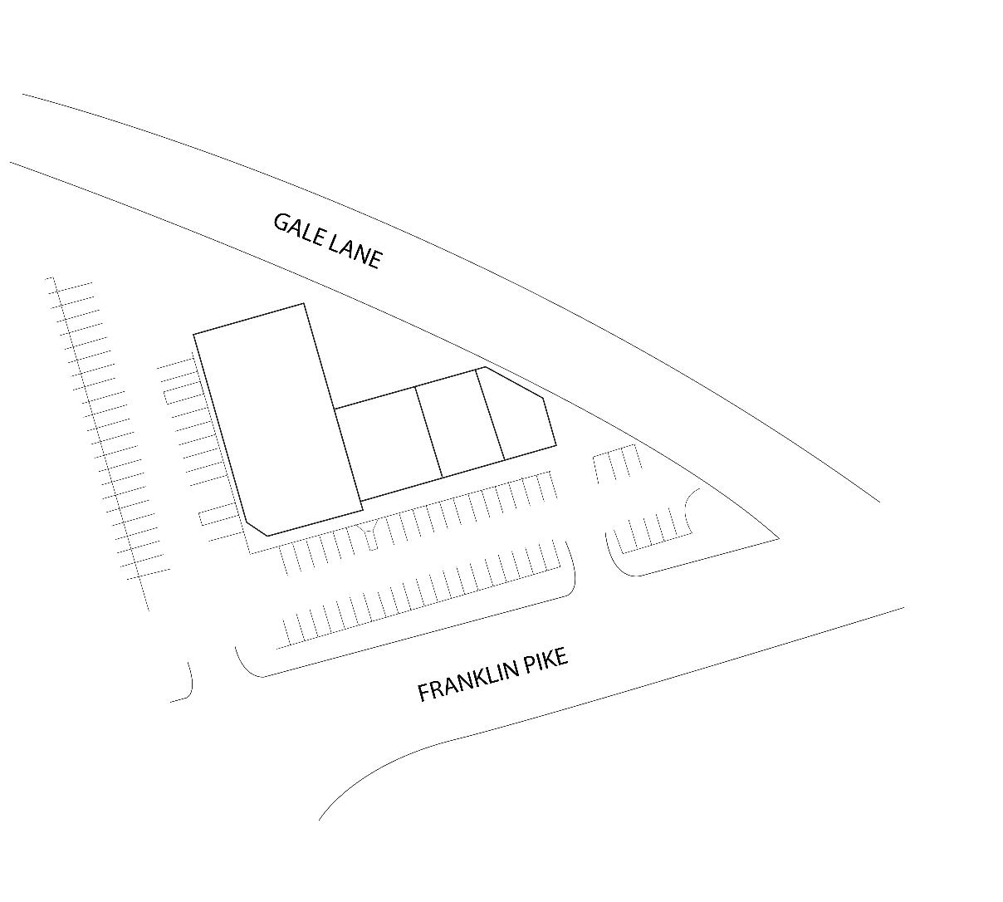

Overview
Located at the corner of Gale Lane & Franklin Pike at I-440
17,000 square foot shopping center
1,700 - 7,350 SF available
23,055 AADT on Franklin Pike
CVS anchor tenant
Exceptional visibility
Multiple access points
Signalized intersection
Abundant parking
Available

Slide 3
Shopping Center Details
ADDRESS:
TOTAL SF:
AVAILABLE SF:
YEAR BUILT:
TRAFFIC COUNTS:
ACCESS TO CENTER:
2645 Franklin Pike
Nashville, TN
17,000 SF
1,700 SF – 7,350 SF
1988 / 2019 Renovated
23,055 AADT along Franklin Pike
Two access points off Franklin Pike; additional access via Gale Lane and Berry Road
The Property

Slide 4
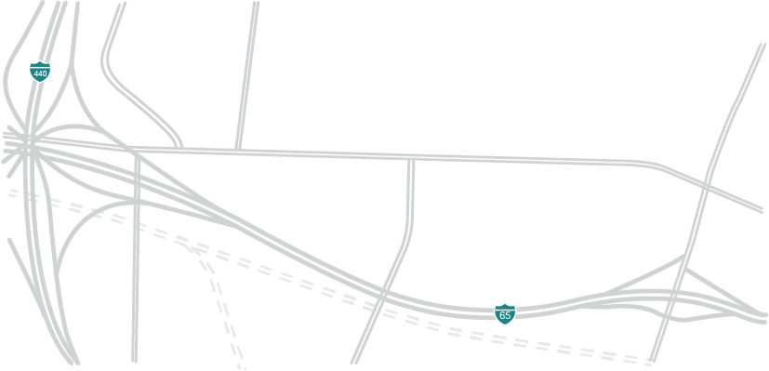


















Location
The Property
Eighth South
52 Units
IMT 8 South
330 Units
The Smiling Elephant
8th Ave. South
Gale Lofts
95 Units
Wedgewood Ave.
23Hundred @ Berry Hill
266 Units
The Melrose Phase II
138 Units
The Melrose Phase I
220 Units
Octave
321 Units

Slide 5
Availability
Suites can be combined for a total of 7,350 SF
3,300 SF
Available
2,350 SF
Available
1,700 SF
Available
w/drive-thru
Drive-thru

Slide 6
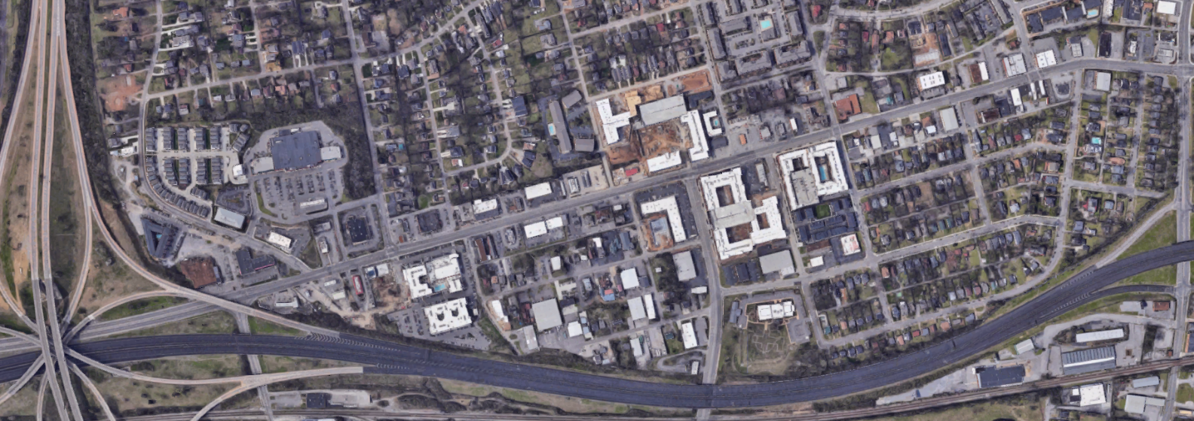


Aerial
24
25
28
23,055 AADT
21
26
27
5
23
1
2
4
22
The Property
18
19
20
7
Wedgewood Ave
10
17
15
16
6
1
3
4
5
9
1
12
13
14
8
11
Franklin Pike/8th Ave S
6
7
2
3
 | Retailers
1 | CVS
2 | Kroger
3 | Jimmy Johns
4 | Krystal
5 | Walgreens
6 | Mapco
7 | McDonalds
8 | Regions
9 | Dollar Tree
10 | M.L. Rose
11 | Sutler
12 | Fenwick’s
13 | Sinema
14 | NTB
15 | Sherwin Williams
16 | Xfinity
17 | SunTrust
18 | Sonic
19 | Holler & Dash
20 | Cilantro
21 | Smiling Elephant
22 | Hattie B’s
23 | Urban Juicer
24 | Shell
25 | Burger King
26 | 8th & Roast
27 | Subway
28 | Exxon
 | Multifamily
1 | Gale Lofts – 95 Units
2 | The Melrose II – 138 Units
3 | The Melrose I – 220 Units
4 | Eighth South – 52 Units
5 | IMT 8 South – 330 Units
6 | Octave – 321 Units
7 | 23Hundred at Berry Hill – 266 Units

Slide 7
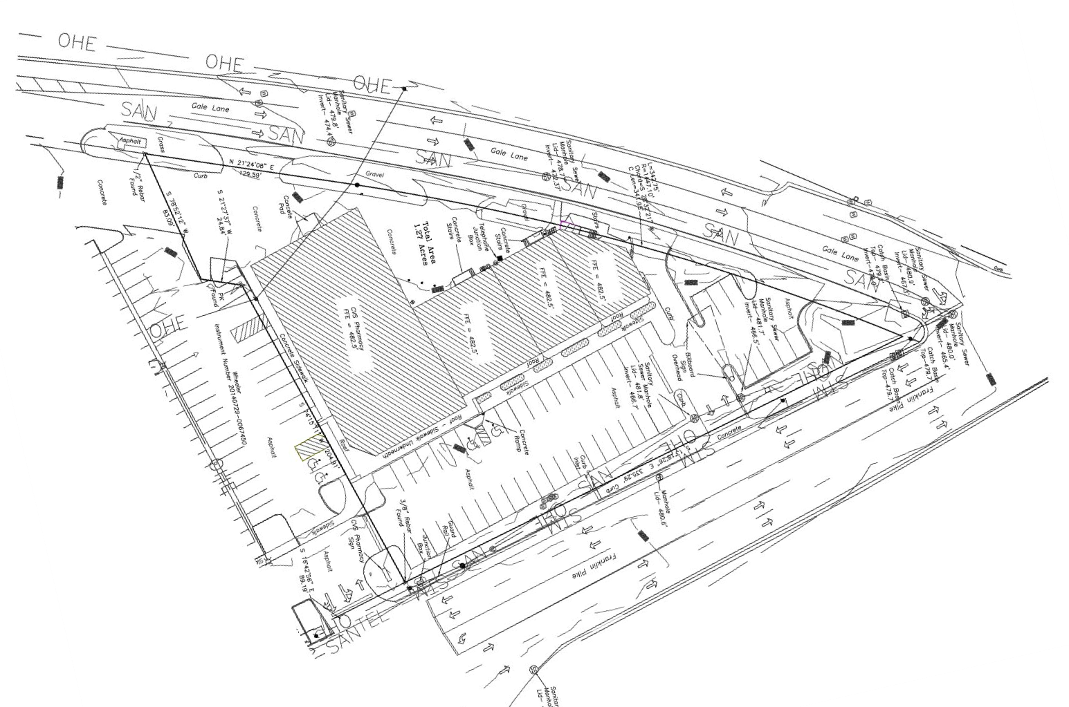
Site Plan

Slide 8
Demographics

Slide 9
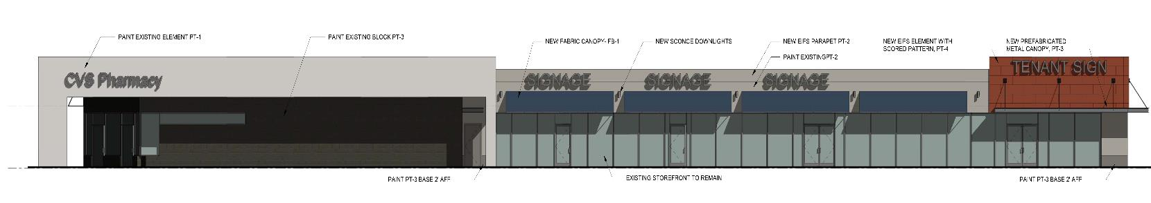
Contact
FOR MORE INFORMATION CONTACT:
CHRIS SMITH
csmith@fidelityreg.com
Fidelity Real Estate Group, Inc.
102 Woodmont Blvd, Suite LL-110
Nashville, TN 37205
P. 615.297.7400

