Slide 1
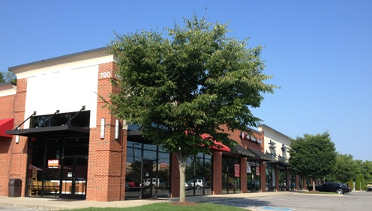
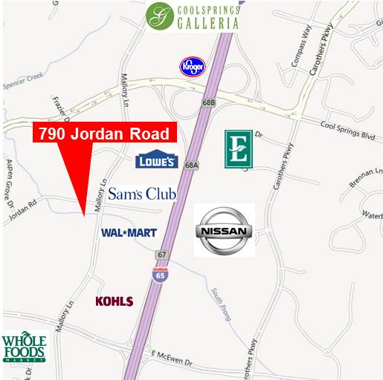
For Lease
Cool Springs Collection
790 Jordan Road
Franklin, TN
Retail space in the heart of Cool Springs
Available space: 1,604 SF
14,112 Total square feet
Built in 2004
Traffic counts: 33,111 cars per day
Williamson County is number one in per capita income in the State of TN
Fidelity Real Estate Group, Inc.
102 Woodmont Blvd, Suite LL-110
Nashville, TN 37205
P. 615.297.7400 F. 615.297.7427
For More Information Contact:
Allison A. Powers, CPM
615.727.0116
apowers@fidelityreg.com

Slide 2
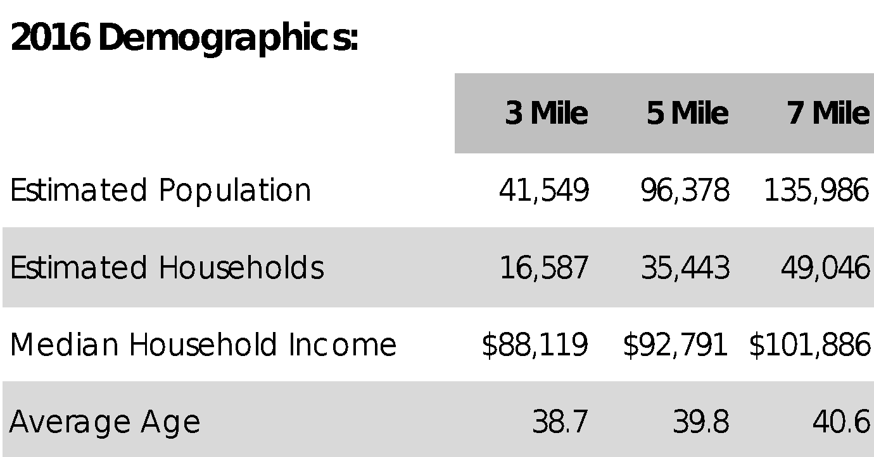
For Lease
Cool Springs Collection
Mattress Gallery Direct
Pawfect
Puppy
Orange Theory Fitness
Snip-its
Brain
Balance
Laser
Derm
CHS
HQ
Healthways
HQ
Nissan
HQ
Site
Fidelity Real Estate Group, Inc.
102 Woodmont Blvd, Suite LL-110
Nashville, TN 37205
P. 615.297.7400 F. 615.297.7427
For More Information Contact:
Allison A. Powers, CPM
615.727.0116
apowers@fidelityreg.com

