Slide 1

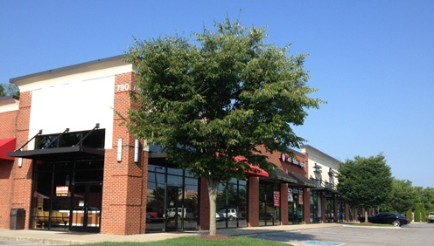
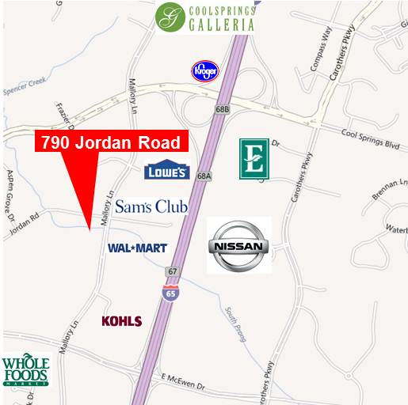
For Lease
Cool Springs Collection
790 Jordan Road
Franklin, TN
Retail space in the heart of Cool Springs
Available Space: 1,604 SF – Suite 104
1,330 SF – Suite 108
1,539 SF – Suite 112
14,112 Total Square feet
Built in 2004
Traffic Counts: 33,111 cars par day
Williamson County is number one in per capita income in the State of TN
Fidelity Real Estate Group, Inc.
102 Woodmont Blvd, Suite LL-110
Nashville, TN 37205
P. 615.297.7400 F. 615.297.7427
For More Information Contact:
Allison A. Powers, CPM
615.727.0116
apowers@fidelityreg.com

Slide 2

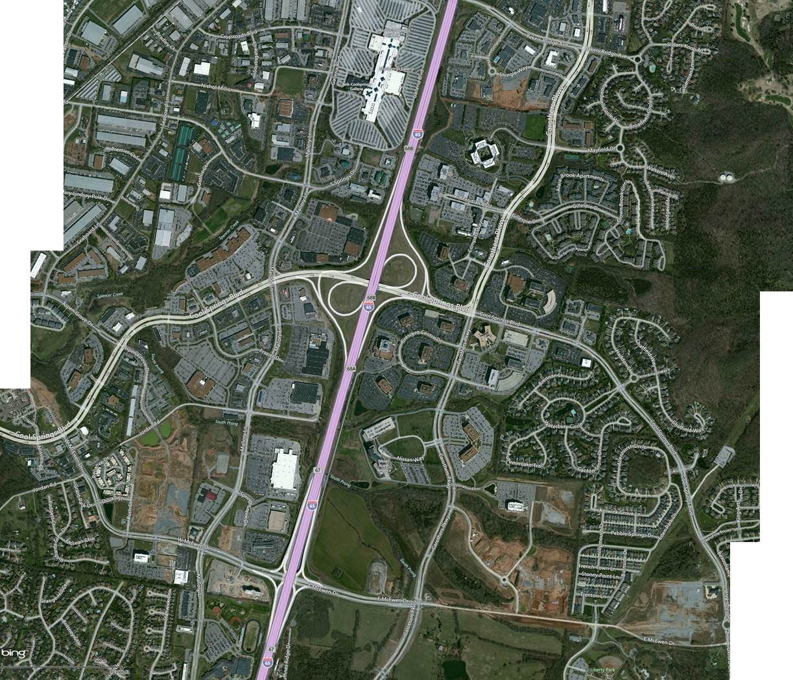

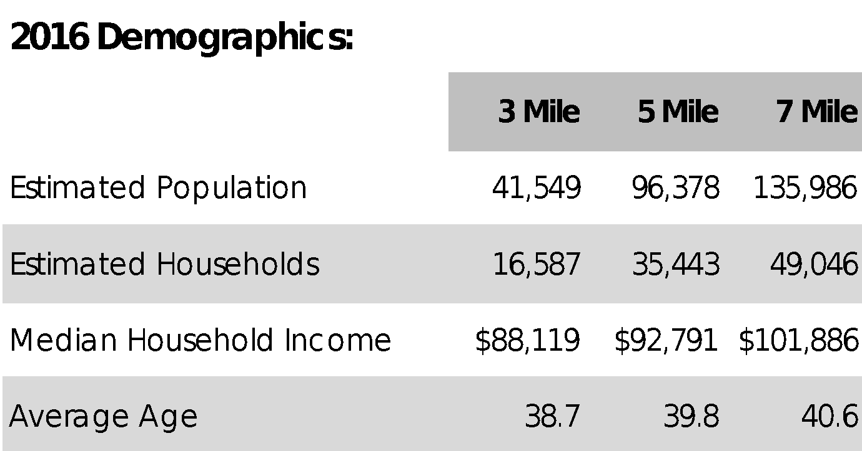




For Lease
Cool Springs Collection
Mattress Gallery Direct
Available
Orange Theory Fitness
Available
Brain
Balance
Available
CHS
HQ
Healthways
HQ
Nissan
HQ
Site
Fidelity Real Estate Group, Inc.
102 Woodmont Blvd, Suite LL-110
Nashville, TN 37205
P. 615.297.7400 F. 615.297.7427
For More Information Contact:
Allison A. Powers, CPM
615.727.0116
apowers@fidelityreg.com

